Slide 1
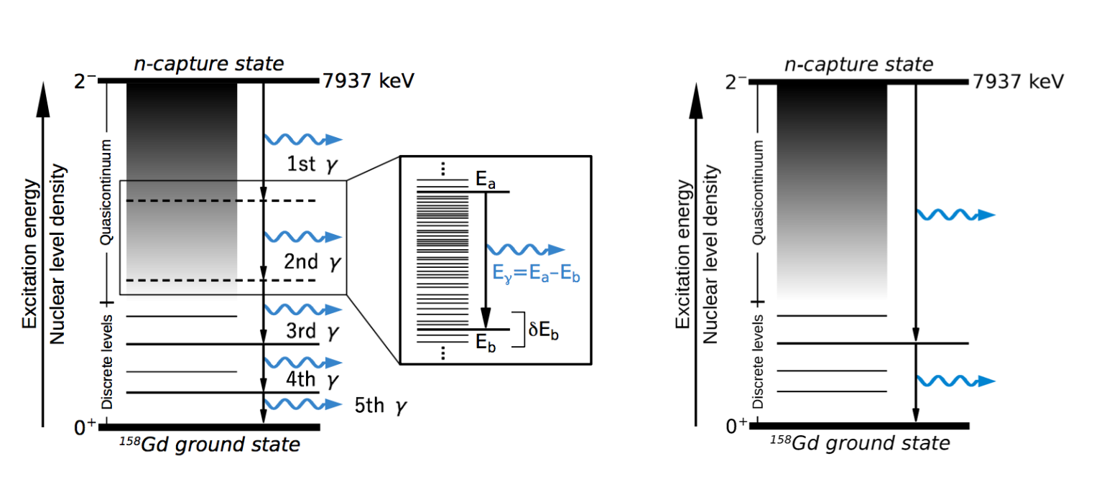
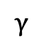
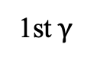
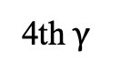
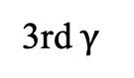
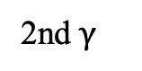
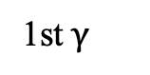
Excited state
1st $γ$
(1)
$$γ$$
Continuum
1st $γ$
(1)
2nd $γ$
(3)
3rd $γ$
(2)
Descrete levels
4th $γ$
Ground state

Slide 2
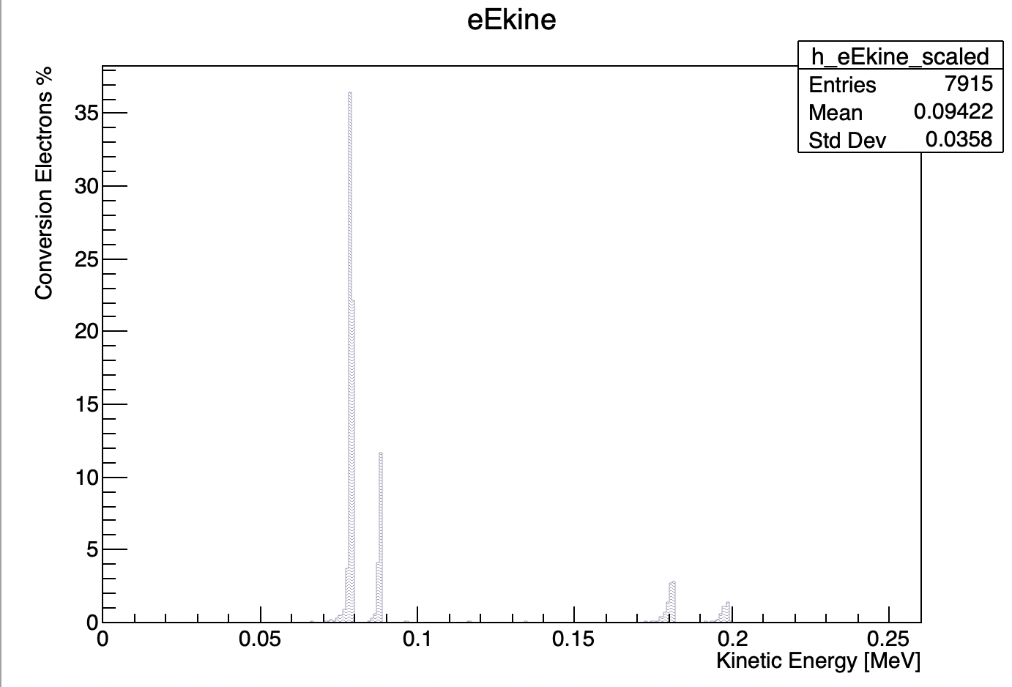
*Per totICE

Slide 3
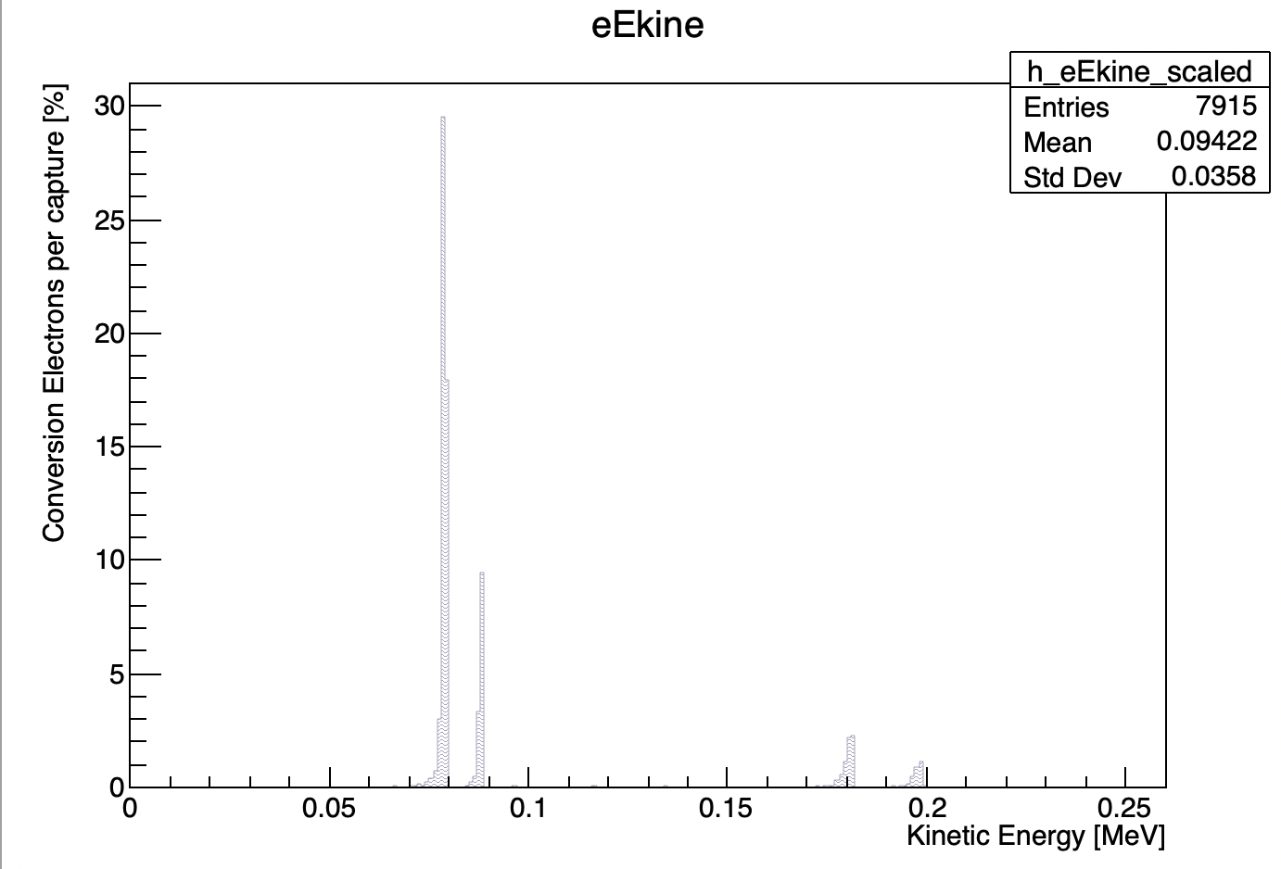

Slide 4
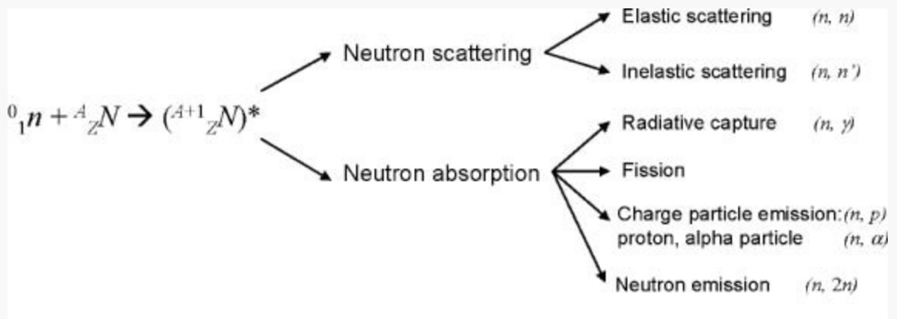
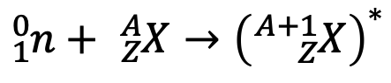
Elastic scattering
Inelastic scattering
Radiative capture
Fission
Charged particle emission
Neutron emission
Neutron scattering
Neutron absorption
$${}_{1}^{0}n+ {}_{Z}^{A}X→{\left({}_{Z}^{A+1}X\right)}^{∗}$$

Slide 5
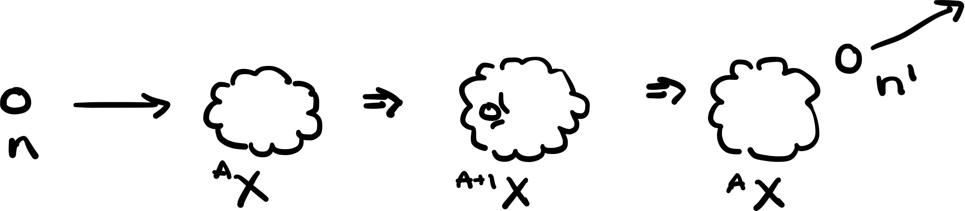
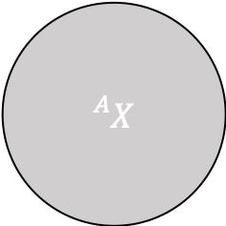
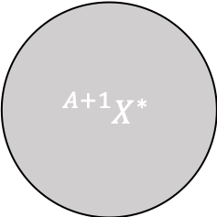

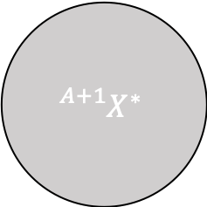


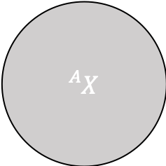
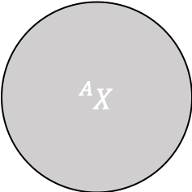
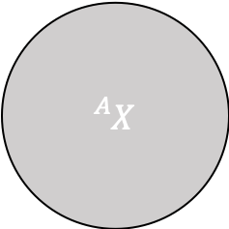
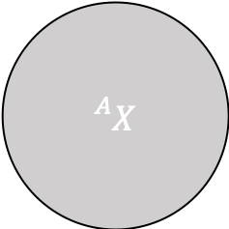

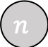


Elastic scattering (n,n’)
$${}_{}^{A}X$$
$$n$$
Before
Intermediate
After
$$n′$$
$${}_{}^{A}X$$
$${}_{}^{A+1}{X^{∗}}$$
$${}_{}^{A}X$$
$$n$$
$$n′$$
$${}_{}^{A}X$$
$${}_{}^{A+1}{X^{∗}}$$
$${}_{}^{A}X$$
$$⇒$$
$$⇒$$
$$n$$

Slide 6


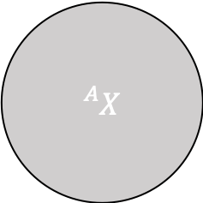
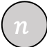
inelastic scattering (n,n)
$${}_{}^{A}X$$
$$n$$
Before
Intermediate
After
$${}_{}^{A}X$$
$${}_{}^{A}X$$
$${}_{}^{A}X$$
$$n$$
$$n$$
$$n$$

Slide 7
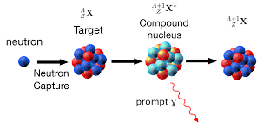
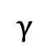

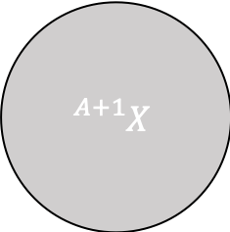

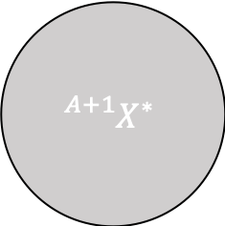
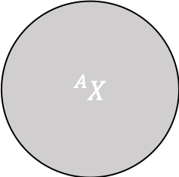
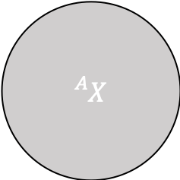
radiative capture
$${}_{}^{A}X$$
$$n$$
Before
Intermediate
After
Compound
nucleus
$$γ$$
$${}_{}^{A}X$$
$${}_{}^{A+1}{X^{∗}}$$
$${}_{}^{A+1}X$$
Prompt
gamma
$$n$$

Slide 8
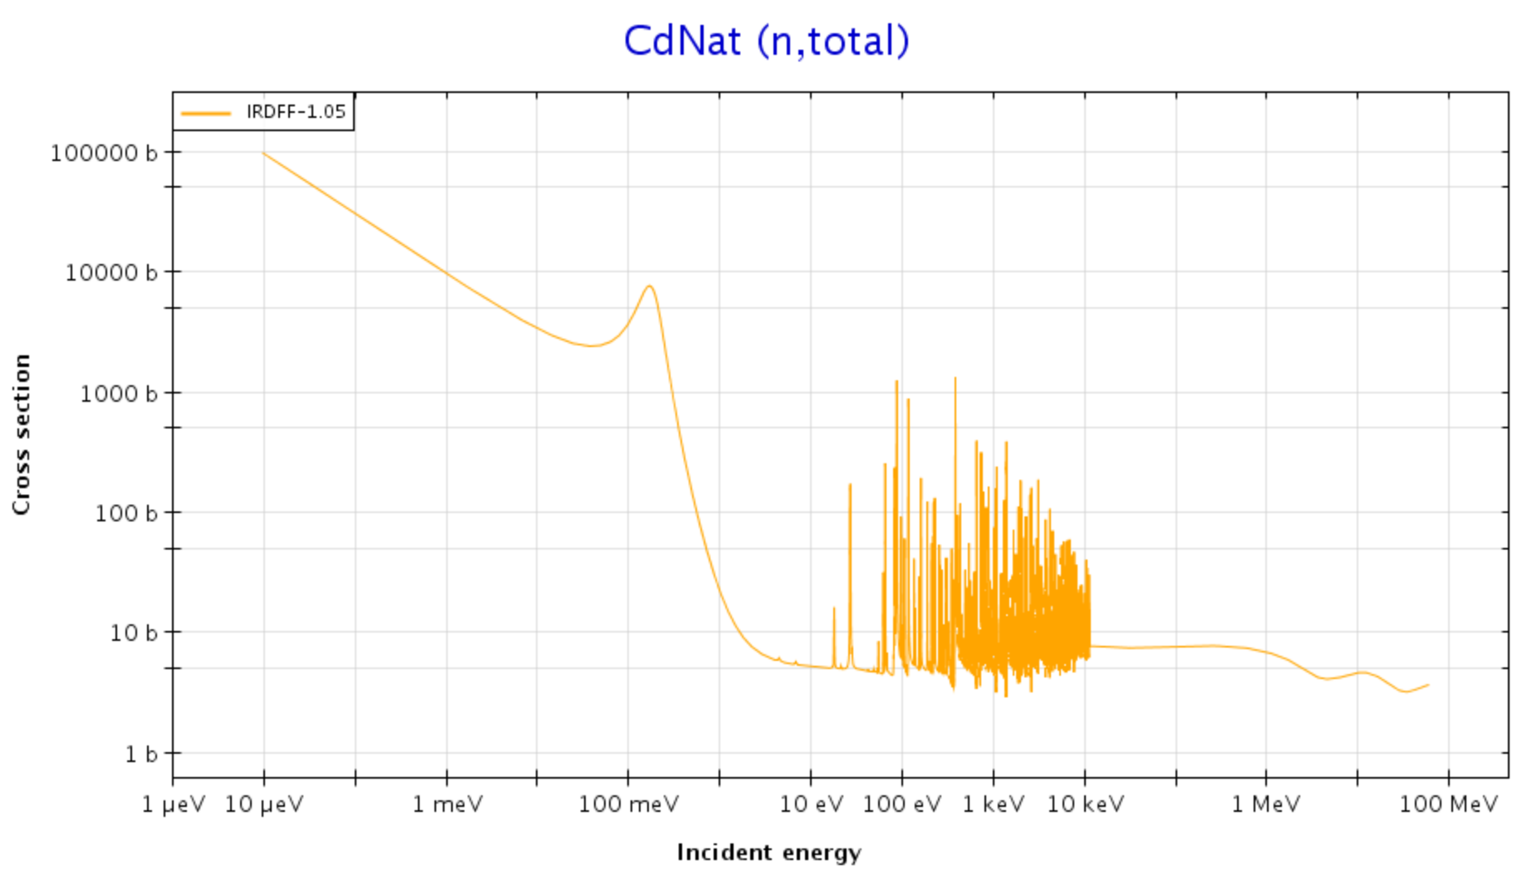
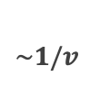
Cadmium
cutoff
$$\sim 1/v$$
Resonance
Low-energy
region
Intermediate-energy
region
High-energy
region

Slide 9
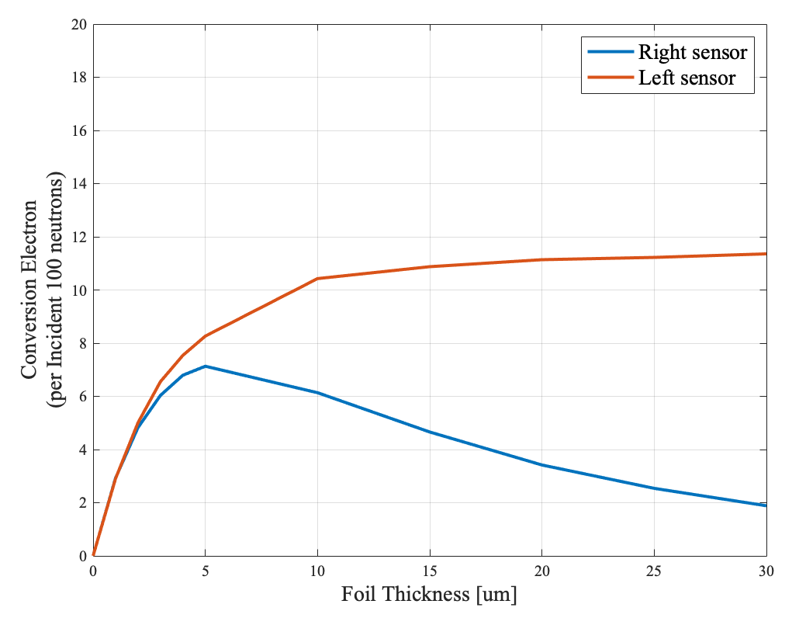
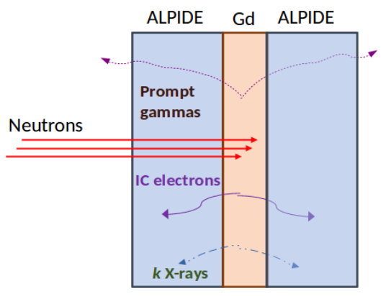
Gd
Neutrons
Gd
Neutrons
sensor
sensor
sensor
sensor

Slide 10
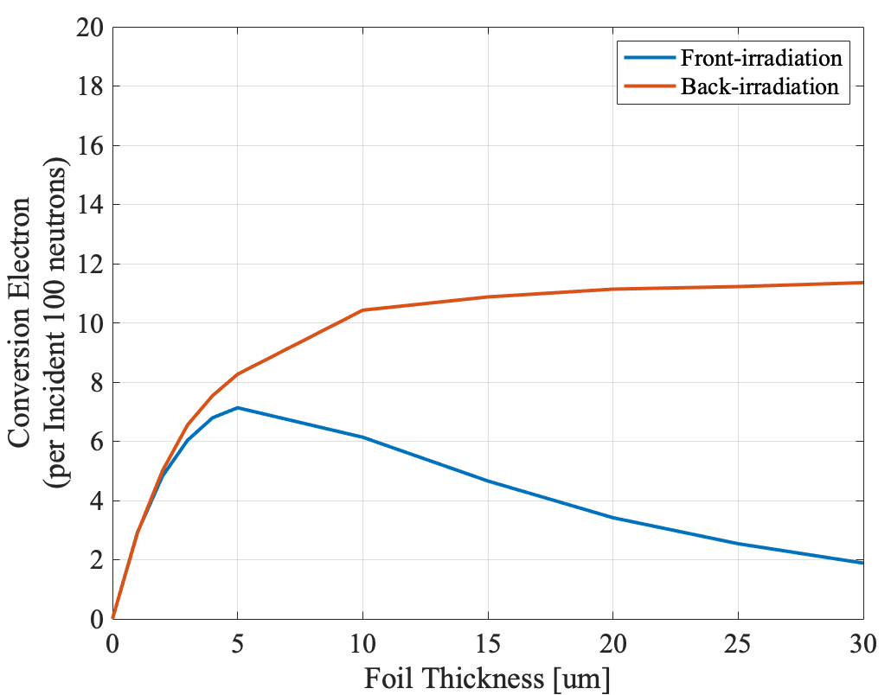
Gd
Neutrons
Gd
Neutrons
sensor
sensor
sensor
sensor

Slide 11
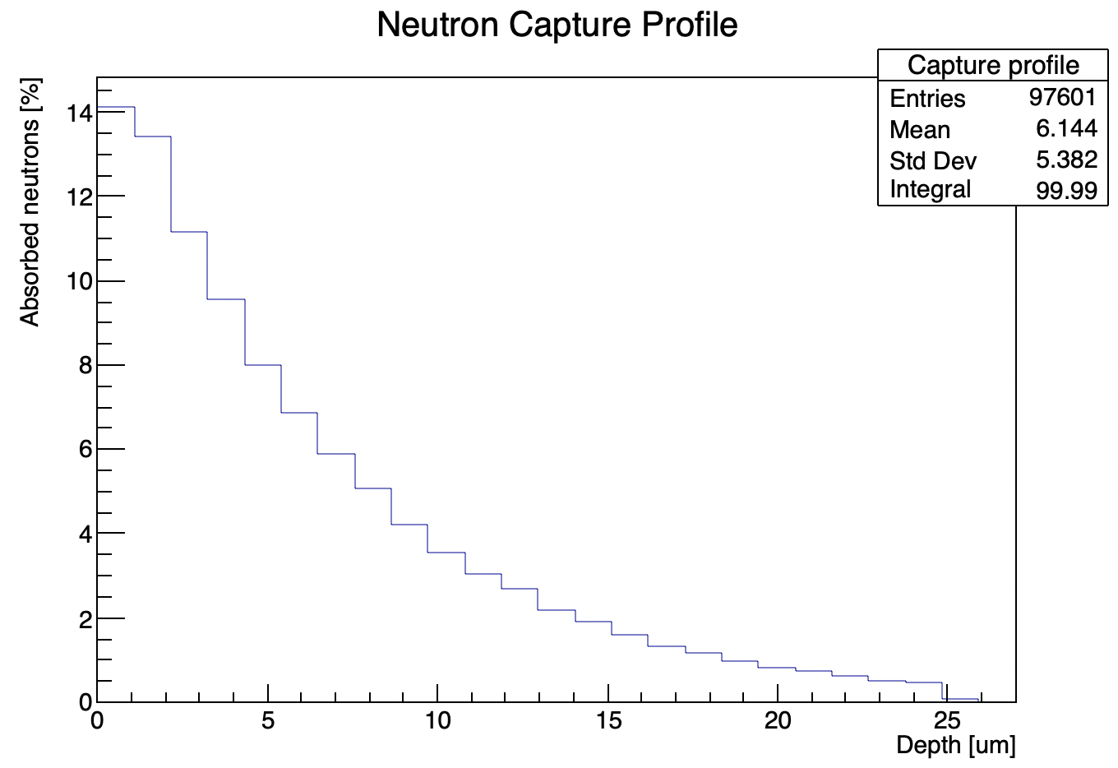
Gd
Neutrons
60%
80%

Slide 12
60%

Slide 13
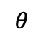
backscattering
Back-
scattering
Multiple
Scattering
$$θ$$
Low energy e-
High Z material

Slide 14
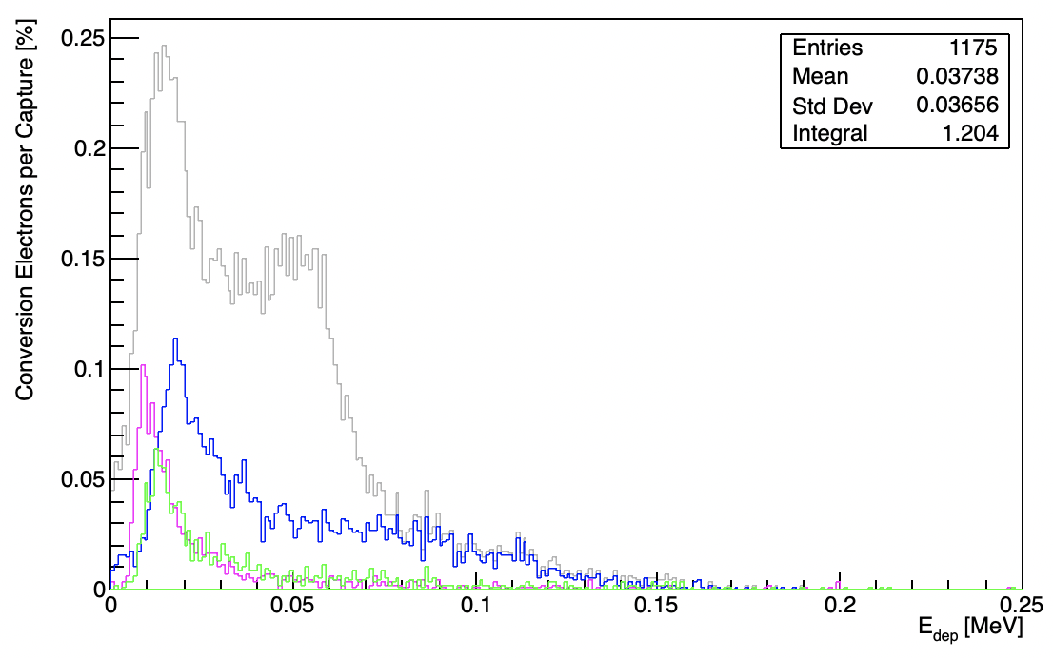
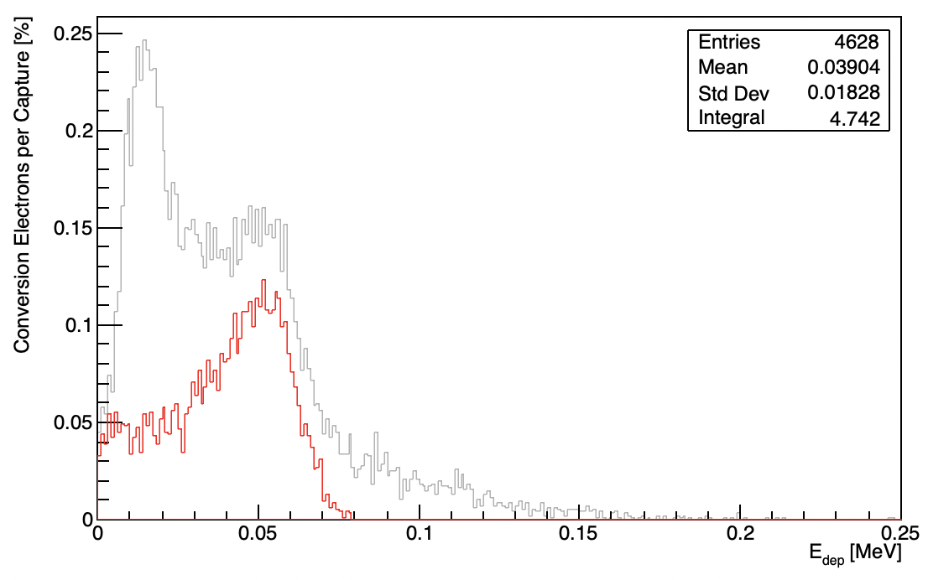
Peak A
B
A

Slide 15
Peak B
B

Slide 16
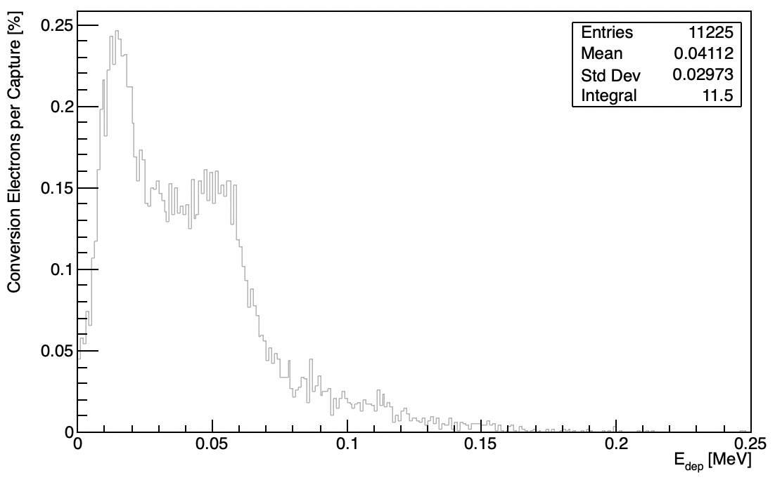
A
B

Slide 20
World Box (Air)
Sensor (Silicon)
Converter foil (Gadolinium)
Neutorn beam (25 meV)
World
World Box (Air)
Sensors (Silicon)
Converter foil (Gadolinium)
Neutorn beam (25 meV)
Sensor 2
Converter foil
Sensor 1
X
Z
Y

Slide 21
World
X
Z
 |  | Feature | Dimension (X,Y,Z) | Position (X,Y,Z)
1 | Neutron beam | Thermal (25meV)
2 | Sensor 1 | Silicon
3 | Converter foil | Natural Gadolinium
4 | Sensor 2 | Silicon
X
Z
Y

Slide 22
World
X
Z
Neutron beam
Sensor
Converter foil
Aluminium layer
(readout electronics)
Active volume
X
Z
Y

Slide 23
World Box (Air)
Sensor (Silicon)
Converter foil (Gadolinium)
Neutorn beam (25 meV)
X
Z
Y

